Slide 1
Goodyear Fire Department Fire & Life Safety Presentation
Grades 2-3
Transportation Safety

Slide 2
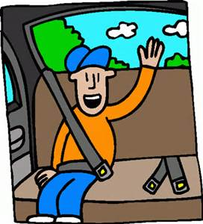
Wear Your Seatbelt… Every Trip Every Time
Notes:
No matter where you go…

Slide 3
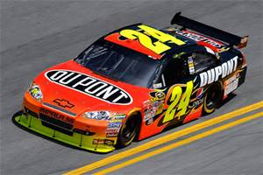
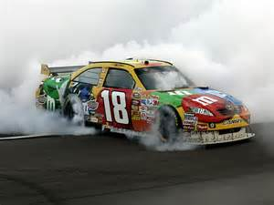
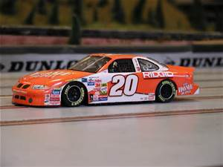
Who Wears Seatbelts?
Notes:
Racecar drivers know the importance of seatbelts. Every time they get in their vehicle the first thing they do is put on their safety gear. That includes seatbelts. Seatbelts are the single most effective traffic safety device for preventing death and injury. According to the National Highway Traffic Safety Administration, wearing a seatbelt can reduce the risk of crash injuries by 50 percent. (National Safety Council)

Slide 4
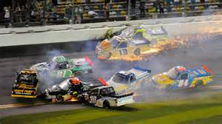
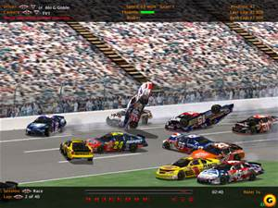
Why do they wear Seatbelts?
Notes:
Accidents can happen at anytime. You never know when something unexpected will happen. If passengers in cars are not properly secured and a crash happens they could be thrown around the inside of the car and also run the risk of being thrown outside of the vehicle.

Slide 5
Let’s do the Math!
30 mph X 60 lbs =
1800 lbs

Slide 6
How do Seatbelts Save lives?

Slide 8
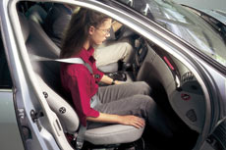
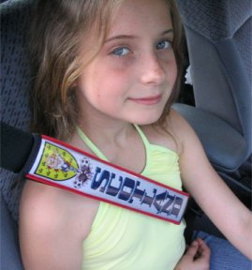
ALWAYS WEAR YOUR SEAT BELTS CORRECTLY
SEAT BELT ACROSS
YOUR CHEST & HIPS

Slide 9
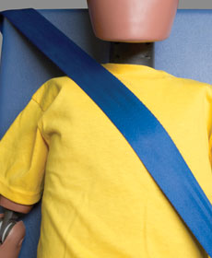
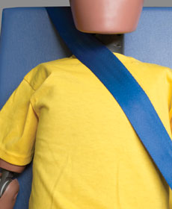
Shoulder belt fit — The shoulder belt should fit across the middle of the shoulder. If it falls off the shoulder or rests on your neck, it won't work as well. Never move the belt to a dangerous position, such as behind the back or under the arm.
Good Belt Position
Dangerous Belt Position
Dangerous Belt Position

Slide 10
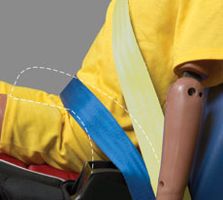
Lap belt fit — The lap belt should lie flat and on top of the thighs, not higher up on the abdomen.

Slide 12
If under the height of 4’ 9” you must use a Safety seat
Safety seats allow you to sit up higher. They make the seat belts fit properly and make your ride much more comfortable!

Slide 13
DO:
Stay calm.
Pull to the right and come to a complete stop.
Be careful when driving around any situation where emergency vehicles are parked.
Don’t:
Don’t panic.
Don’t stop in the middle of the road.
Don’t race ahead to get through a traffic light or turn before emergency vehicle gets there.

Slide 14
Buckle-Up Pledge
I pledge to wear my safety belt every time I ride in a motor vehicle regardless of where I am sitting or how long the trip is.
I want to start a habit for life.

Slide 15
The end

